Slide 1
Exploring Investment Income
Securities
Dividends
Home Sale
Interest
Notes:
Instructor Note
The purpose of this presentation is to review the effects of investment income on the return by exploring how it is taxed differently from ordinary income. Volunteers will be able to practice entering information in TaxSlayer. Discussion questions are included to help reinforce the tax law associated with investment income and the volunteers will be directed to review resources if applicable. There is also a scope discussion at the end of the presentation..

Slide 2
Exploring Investment Income
Log onto your TaxSlayer Account
Begin a new return for Ray and Mary Mason filing MFJ with two dependents

Slide 3
Manager
Phone: 904 555-1234
Housewife

Slide 4
Twins: DOB 4/16/2013

Slide 5
Use This Table to Track Results
TYPE OF INCOME | AGI | TAX LIABILITY | FEDERAL REFUND | NJ REFUND | NOTES
Ordinary dividends |  |  |  |  | Taxed at ordinary income tax rates
Qualified dividends |  |  |  |  | Taxed at capital gains tax rates
Taxable interest |  |  |  |  | Taxed at ordinary income tax rates
Interest on US Savings Bond |  |  |  |  | Taxable on Federal return; tax-exempt on NJ return
Capital gains distribution vs. interest |  |  |  |  | Capital gains distribution taxed at lower capital gains rate; interest taxed at higher ordinary income tax rates
Short-term capital gains |  |  |  |  | Taxed at ordinary income tax rates
Long-term capital gains |  |  |  |  | Taxed at capital gains rates
Capital gains on inherited stock |  |  |  |  | Cost basis is FMV on date of death
Tax-exempt interest on NJ Turnpike bond |  |  |  |  | Tax-exempt on both Federal and NJ returns
Tax-exempt interest on CA bond |  |  |  |  | Tax-exempt on Federal; taxable for NJ
Exempt interest dividends on Consolidated Statement |  |  |  |  | $76 added as a Taxable State Dividend
Notes:
Instructor Note:
Instructors can also prepare copies of this chart as handouts if desired

Slide 6
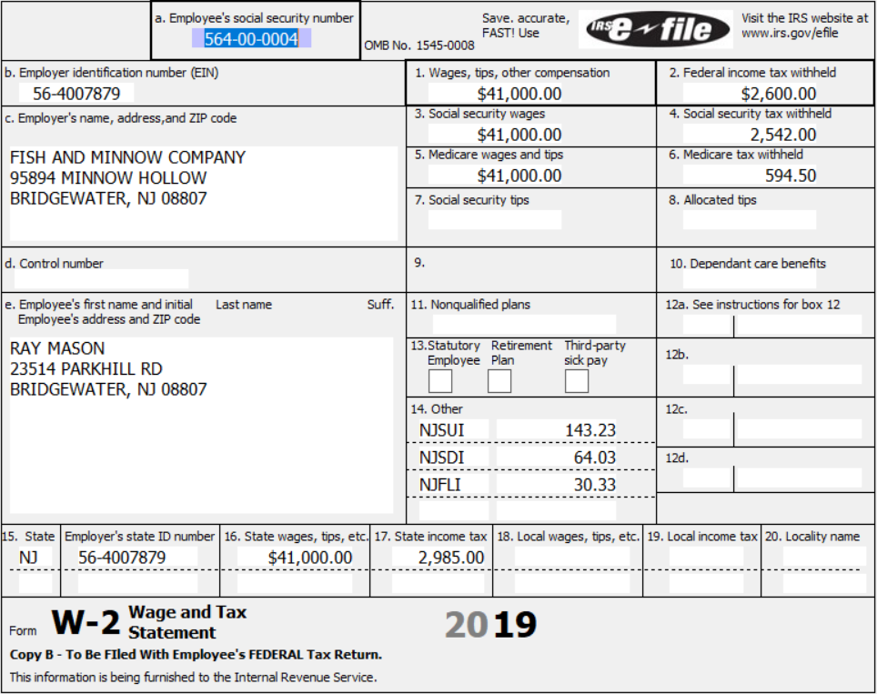
W-2
Why are Federal and NJ refunds higher than amounts withheld on W-2?
Notes:
Instructor Notes:
Direct volunteers to enter the W-2. If asked Ray’s employer provides healthcare for Ray and his family.

Slide 7
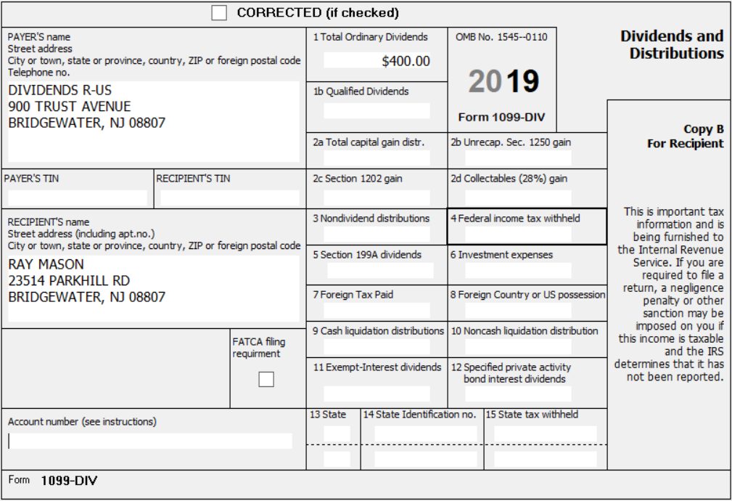
Ordinary Dividends
Fill in your worksheet
as we do each entry
Notes:
Instructor Notes:
Direct volunteers to enter the 1099-DIV with just Ordinary Dividends

Slide 8
Use This Table to Track Results – Ordinary Dividends
What is the Mason’s AGI? Tax Liability? Federal Refund? NJ Refund?
Compare your table:

Slide 9
All Dividends are Qualified
Why did Federal tax liability go down and refund go up?
Why didn’t NJ refund change?
Notes:
Instructor Notes:
Direct volunteers to enter the Qualified Dividends

Slide 10
Qualified Dividends
Notes:
Instructor Notes:
Discuss that ordinary dividends are taxed at ordinary income tax rates, while qualified dividends are taxed at capital gains rates. Capital gains rates are much lower (can even be 0%)

Slide 11
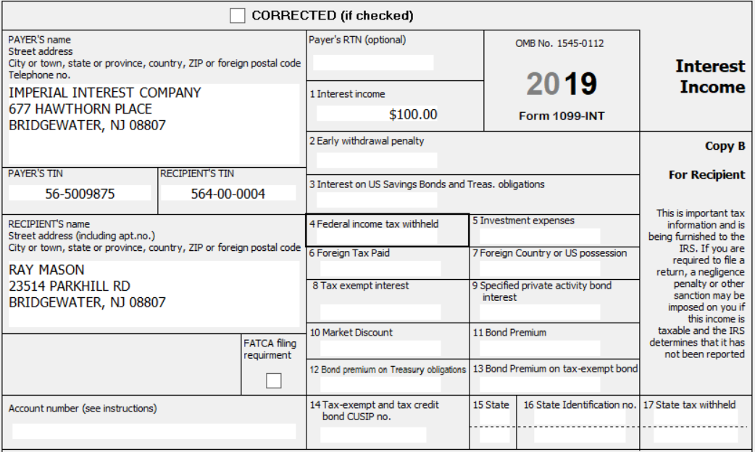
Interest Income
Notes:
Instructor Notes:
Direct volunteers to enter the 1099-INT

Slide 12
Taxable Interest

Slide 13
Interest on US Savings Bond
Assume the interest on the 1099-INT was from a US Savings Bond. Where would the interest be reported on the 1099-INT? Edit the 1099-INT
What is the tax law for NJ on US Savings Bond interest? How do you reflect the NJ tax law in TaxSlayer? Make the additional entry on the 1099-INT screen
What happened to the Federal refund? the NJ refund?
Notes:
Instructor Notes:
Interest on US Savings Bonds would appear on the 1099-INT in Box 3. It is taxable interest for the Federal
Interest on US Savings Bonds are not taxable for NJ. Enter the interest amount on the line that says, “Amount of interest on US Saving Bonds and Treasury Obligations that you want subtracted from your state return”
Federal refund went down; NJ refund increased

Slide 14
Interest on US Savings Bond

Slide 15
Capital Gain vs. Interest
Assume that Ray had the $100 reported on line 2a (Total Capital Gain Distributions) of his 1099-DIV instead of receiving the $100 as interest
Delete 1099-INT for $100 Interest
Edit Ray’s 1099-DIV by entering $100 in box 2a
Notes:
Instructor Notes:
Direct volunteers to delete the $100 interest previously entered and to edit the existing 1099-DIV data entry form by adding $100 to box 2a Capital Gain.

Slide 16
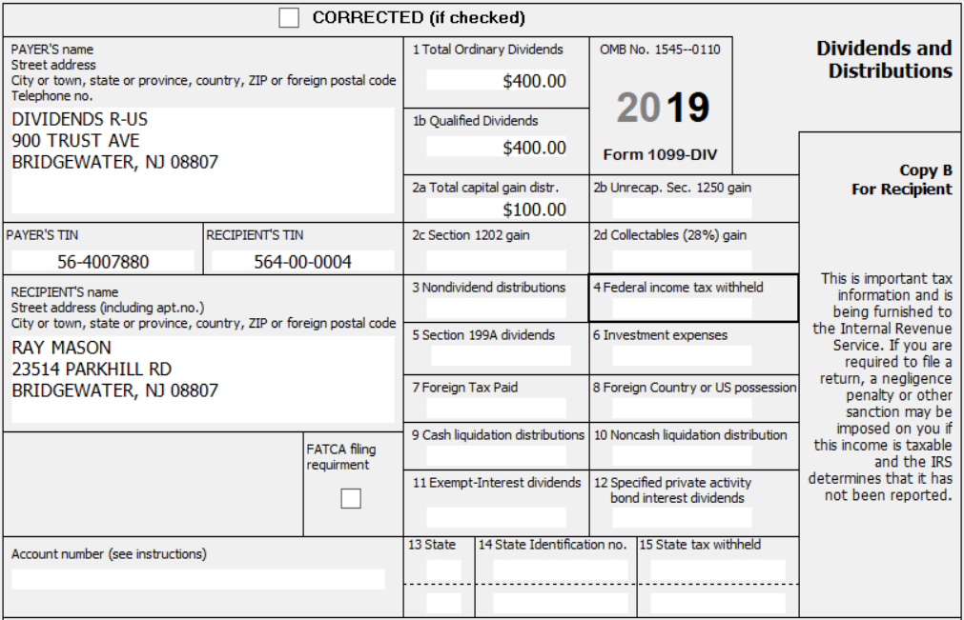
Capital Gain Distributions
Notes:
Instructor Note:
Direct volunteers to enter the 1099-DIV

Slide 17
Capital Gain vs. Interest
Note that the AGI remained the same but the Federal refund increased. Why?
Why did the NJ refund go back down?
Notes:
Instructor Notes:
This reinforces the tax law that interest is taxed as ordinary income while capital gains are taxed at a lower rate

Slide 18
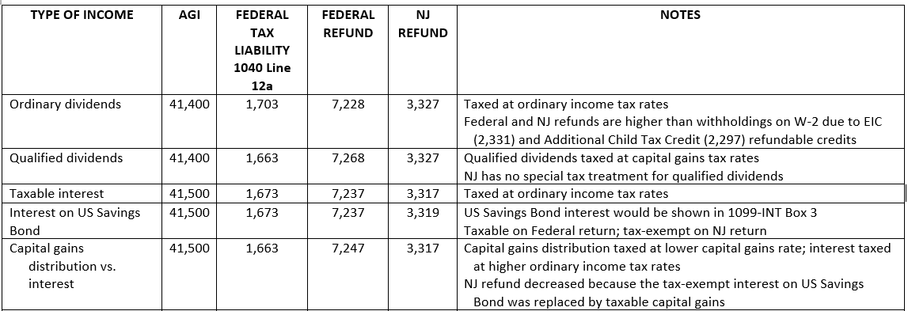
Capital Gain vs. Interest

Slide 19
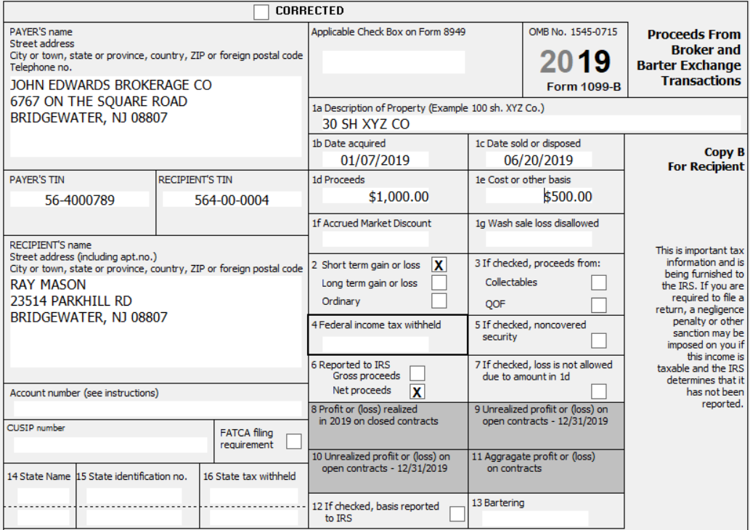
Short-Term Capital Gains
Notes:
Instructor Notes:
Direct volunteers to enter the information in the capital gains section
Note that this is a short-term gain

Slide 20
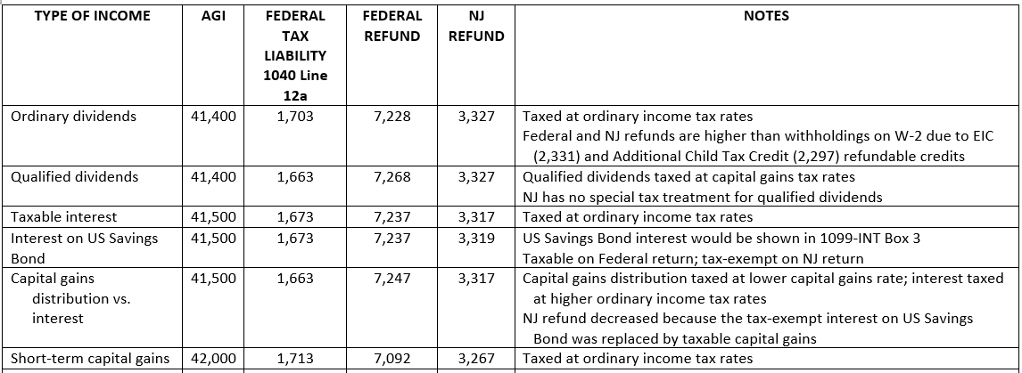
Short-Term Capital Gains

Slide 21
Long-Term vs. Short-Term Capital Gains
Change the date acquired on Ray’s 1099-B to 1/7/2012
What happened to AGI? Federal Tax Liability? Federal Refund? NJ Refund?
Why?
Notes:
Instructor Notes:
This reinforces the tax law that short term gains are taxed at a higher rate than long term gains. The idea is to encourage taxpayers to invest for the future (long term goals) rather than generating short term income.

Slide 22
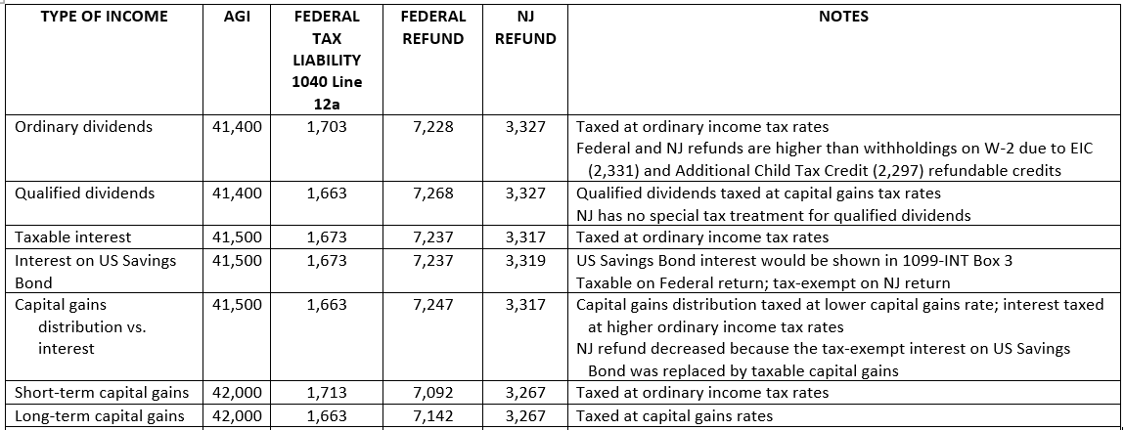
Long-Term Capital Gains

Slide 23
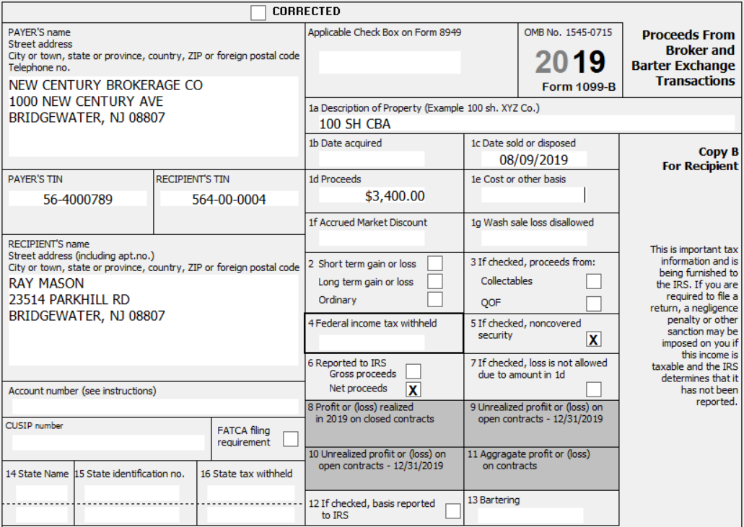
Let’s look at another 1099-B
Ray has a second 1099-B
What probing questions do you ask?
Notes:
Instructor Notes:
This is an opportunity to reinforce interviewing skills. In this scenario it is inherited stock, but a 1099-B like this could simply represent stock that was brought over from one financial institution to another without the basis
Since this is an inherited stock scenario it is an opportunity to review the tax law regarding the basis and the fact that all inherited stock is long term.

Slide 24
Inherited Stock
Ray reports the following:
He inherited stock from his uncle who had purchased it on 1/10/2012 for $8 a share
His uncle died on 3/6/2012; the price per share was $10 on the day of death
What would the date acquired be? What would the cost basis be?
What if Ray inherited it and sold it in 2019? Short- or long-term?
What if he inherited it in 2010?
Notes:
Instructor Notes:
Instructors need to lead the discussion but let the volunteers do the work. What resources should they be directed to? Pub 4012? Form 8949 Instructions? NTTC Scope Manual?
-- Reinforce that inherited stock is ALWAYS long term even if inherited and sold in same year
-- Remember the rules were different for stock inherited in 2010. The taxpayer must provide the basis for the stock which may be difficult since they may not know when it was purchased
-- Many sites have resources for looking up historical stock prices which can help taxpayers determine basis
-- Also a good time to review Form 8949 and it’s A, B, and C codes
Many LCs have resources at the site for determining past stock prices so this would be a good time to discuss those resources. Some districts require the Taxpayer to do the research. Good time to discuss district/site policies.

Slide 25
Inherited Stock
cont’d
What would you do if Ray did not know the cost basis?
What box will be checked on Form 8949?
Notes:
Instructor Notes:
Instructors need to lead the discussion but let the volunteers do the work. What resources should they be directed to? Pub 4012? Form 8949 Instructions? NTTC Scope Manual?
-- Reinforce that inherited stock is ALWAYS long term even if inherited and sold in same year
-- Remember the rules were different for stock inherited in 2010. The taxpayer must provide the basis for the stock which may be difficult since they may not know when it was purchased
-- Many sites have resources for looking up historical stock prices which can help taxpayers determine basis
-- Also a good time to review Form 8949 and it’s A, B, and C codes
Many LCs have resources at the site for determining past stock prices so this would be a good time to discuss those resources. Some districts require the Taxpayer to do the research. Good time to discuss district/site policies.

Slide 26
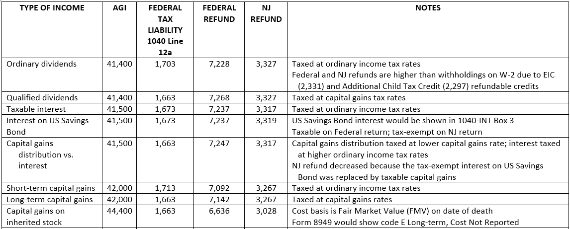
Inherited Stock – Long-Term Capital Gain
Notes:
Instructor’s Notes:
Capital Gains rate is 0% for taxable incomes up to $77,200 for MFJ so there is no additional tax liability

Slide 27
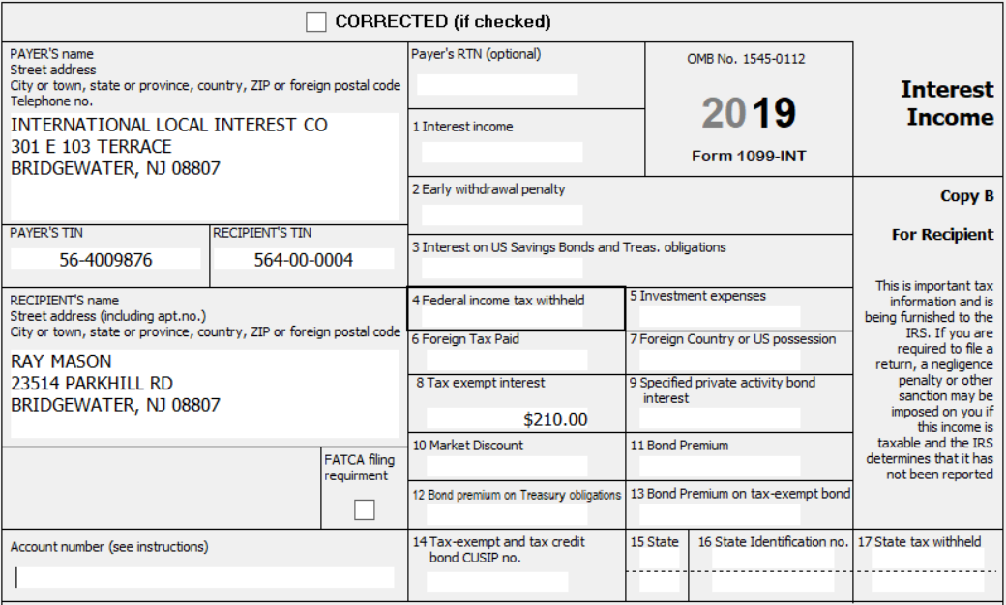
Tax-Exempt Interest on NJ Turnpike bond
You ask Ray if he has any other income
He shows you a 1099-INT with tax-exempt interest on a Newark Utility Authority bond
He said he didn’t think he needed to report it because it is tax-free
What do you tell him?
Notes:
Instructor Notes:
Explain to Ray that tax-exempt interest must still be reported even if it is not taxable
Discuss how tax-exempt interest can impact other part’s of the return, such as taxability of Social Security

Slide 28
Tax-Exempt Interest
YIKES! – What happened? Why did the refund decrease so much?
Open Pub 4012 page I-2 EIC Eligibility and find the answer
RAY
Notes:
Instructor Note:
This reinforces the tax law associated with investment income and EIC
Investment income for Masons includes interest, tax-exempt interest ($110), dividends ($400), capital gains distributions ($100), and capital gains ($2,900). Therefore, the Mason’s investment income is now $3,510, and they are no longer eligible for EIC
It could also be a time to promote discussion on how volunteers would handle unpleasant situations with a tax payer.
It could also be a time to reinforce standards of conduct. For example, what if the taxpayer had disclosed a small amount of bank interest that was not reported on a tax document and it caused a loss of EIC? Would there be a temptation to “unhear” that statement?

Slide 29
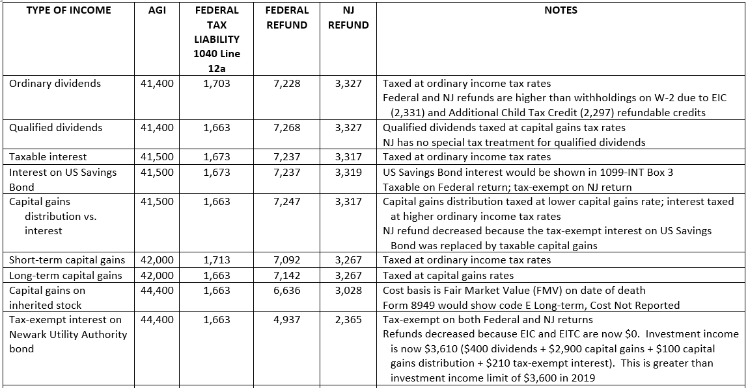
Tax-Exempt Interest on Newark Utility Authority Bond
Notes:
Instructor’s Notes:
Capital Gains rate is 0% for taxable incomes up to $77,200 for MFJ so there is no additional tax liability

Slide 30
Tax-Exempt Interest on CA bond
What would change if the interest was for a CA bond?
What do you have to do differently in TaxSlayer?
Notes:
Instructor’s Notes:
Interest would still be tax exempt on the Federal, but it would be taxable for NJ
Add Taxable State Interest of $110 on 1099-INT screen

Slide 31
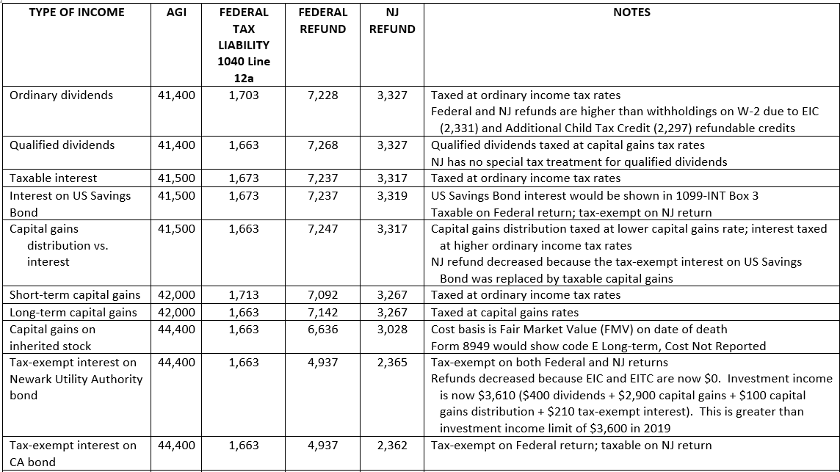
Tax-Exempt Interest on Bond from State Other than NJ

Slide 32
Capital Gains Tax Rates
Why did tax liability change when you added even small amounts of taxable interest, ordinary
dividends and short-term capital gains, but didn’t change at all when you added long-term
capital gains or qualified dividends ?
Type of income | Added Income | Added Tax Liability
Ordinary dividends | +$400 | +$40
Taxable interest | +$100 | +$10
Short-term capital gains | +$500 | +$50
Inherited capital gains (L/T) | +$2,400 | $0
Qualified dividends | +$400 | $0
Notes:
Instructor Notes:
Note that as different amounts of qualified dividends and capital gains were added, the tax remained the same while when small amounts of ordinary income were added the tax bill did change
Capital gains 0% tax rate extends all the way up to $77,200 for MFJ. However, ordinary income tax rates change for every $50 change in taxable income
Show ordinary income tax tables https://www.irs.gov/pub/irs-dft/i1040tt--dft.pdf

Slide 33
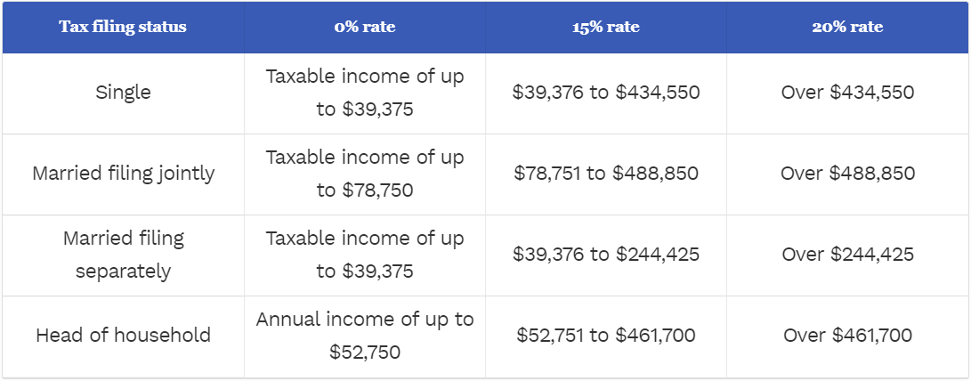
2019 Capital Gains Tax Rates
Taxable income of up to $52,750

Slide 34
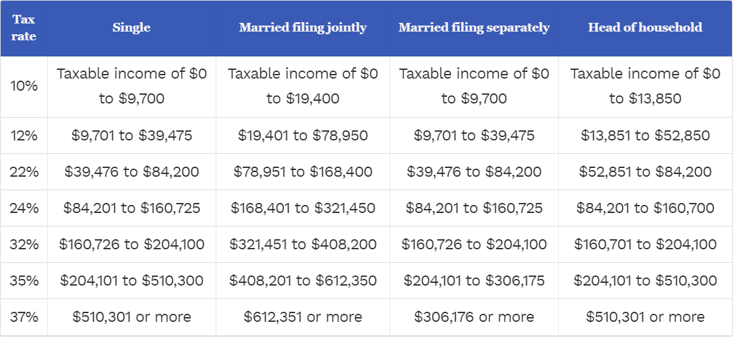
2019 Ordinary Income Tax Rates

Slide 35
Consolidated Brokerage Statement
Let’s look at a Consolidated Brokerage Statement to see what info is reported
May contain 3 different tax forms: 1099-INT, 1099-DIV, and 1099-B (reported to IRS)
May also contain numerous back-up pages to provide details behind the 3 tax forms (not reported to IRS)

Slide 36
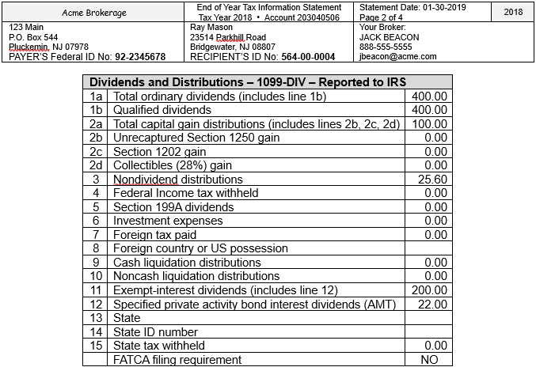
Change values on
previous 1099-DIV
already entered
into TSO
Notes:
Instructor Note:

Slide 37
Additional Info on the Consolidated Brokerage Statement
Non-dividend distributions
Return of principal
Do not impact tax return. Reduce the cost basis of underlying asset
Foreign tax paid
Can claim a credit on Sch 3 Line 48 for the amount of foreign tax paid
Must be less than $300/$600 (MFJ) to be in scope
Specified private activity bond interest dividends
Not normally taxable unless taxpayer is subject to Alternative Minimum Tax (AMT)
Reported on Form 6251
If AMT is triggered on Sch 2 Line 45, return becomes out of scope

Slide 38
Exempt Interest Dividends from Mutual Funds
Tax exempt on Federal return
Taxability varies for NJ, depending on bonds held by fund (look at detail pages)
Interest attributable to Federal obligations (including P.R., territories, U.S. Possessions, etc.) always tax exempt
Interest attributable to other states except NJ always taxable
Interest attributable to NJ bonds only tax exempt if fund is “NJ Qualified Investment Fund” (usually has NJ in name of fund)
Interest on NJ bonds held individually by taxpayer (not in a mutual fund) always tax exempt

Slide 39
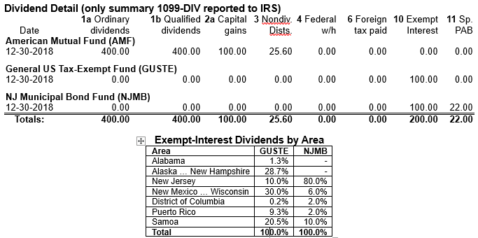
Detail pages to back up dividends ($200) shown on 1099-DIV

Slide 40
Exempt Interest Dividends on Consolidated Brokerage Statement – NJ Taxability
For General US Tax-Exempt Fund – general bond fund
What % of the interest is attributable to Federal obligations? - Always tax exempt
What % of the interest is attributable to NJ bonds? - Tax exempt or taxable?
What % of the interest is attributable to states other than NJ? - Always taxable
30% tax exempt 70% taxable
Notes:
Instructor Notes:
% attributable to Federal obligations - 30% tax exempt
% attributable to NJ bonds - 10% taxable
% attributable to states other than NJ - 60% taxable

Slide 41
Exempt Interest on Consolidated Brokerage Statement – NJ Taxability
For NJ Municipal Bond Fund – NJ qualified investment fund
What % of the interest is attributable to Federal obligations? - Always tax exempt
What % of the interest is attributable to NJ bonds? - Tax exempt or taxable?
What % of the interest is attributable to states other than NJ? - Always taxable
94% tax exempt 6% taxable
Notes:
Instructor Notes:
% attributable to Federal obligations - 14% tax exempt
% attributable to NJ bonds - 80% tax exempt
% attributable to states other than NJ - 6% taxable

Slide 42
Tax-Exempt Interest on Consolidated Brokerage Statement – NJ Taxability
GUSTE (general bond fund) |  | NJMB (NJ qualified investment fund)
30% (Tax Exempt) | Federal bonds - Tax Exempt | 14% (Tax Exempt)
10% (Taxable) | NJ bonds - Tax Exempt or Taxable? | 80% (Tax Exempt)
60% (Taxable) | Bonds from other states - Taxable | 6% (Taxable)
30% Tax Exempt ($30) 70% Taxable ($70) | Total | 94% Tax Exempt ($94) 6% Taxable ($6)
Total of $76 should be added as Taxable State Dividend
Notes:
Instructor Note:
$76 is taxable for NJ - needs to be added as a Taxable State Item
$124 is tax exempt – nothing needs to be done

Slide 43
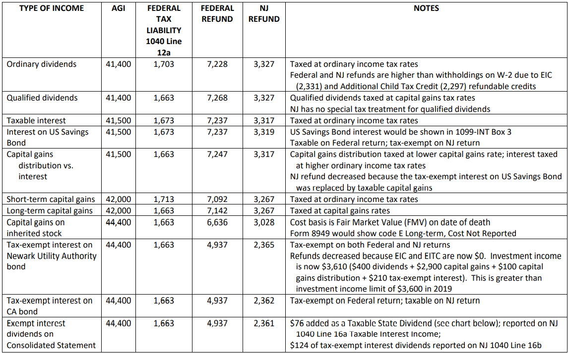
NJ Taxable State Dividend

Slide 44
Consolidating Capital Gains Transactions on Capital Gains/Loss Screen
When 1099-B has numerous capital gains transactions, you do not have to enter each one separately
Divide the transactions into 4 categories:
Short-term transactions with basis reported to the IRS (Box A checked on 8949)
Short-term transactions with basis not reported to the IRS (Box B checked on 8949)
Long-term transactions with basis reported to the IRS (Box D checked on 8949)
Long-term transactions with basis not reported to the IRS (Box E checked on 8949)

Slide 45
Consolidating Capital Gains Transactions on Capital Gains/Loss Screen
cont’d
Enter the total of each category on a separate TSO capital gain entry screen
Choose adjustment reason that states, “Reporting multiple transactions on a single row” from list (adjustment code M); enter 0 as adjustment amount
If any of the transactions in that category also require another adjustment, just select another reason from the check boxes; okay to choose multiple adjustment explanations
Add adjustment amounts together and enter total
For transactions where the cost basis is not reported to the IRS (Box B/Box E checked), inform the taxpayer that the IRS may request copies of the brokerage statement as proof
Do not attach any documents to e-file or mail any documents to IRS

Slide 46
Wash Sales
Definition of a wash sale:
A stock/fund sold by taxpayer at a loss and substantially equivalent stock/fund is purchased within 30 days (either before or after sales date)
The loss is not deductible
1099-B, brokerage statement will show:
Original sales price in Box 1d & cost in Box 1e
Wash Sales Disallowed
Enter as an adjustment to a capital gain/loss
Choose “Nondeductible Loss from a Wash Sale” as the adjustment explanation
Enter as a positive number to increase profit/reduce loss
Add disallowed loss to cost basis of new stock bought
Notes:
46

Slide 47
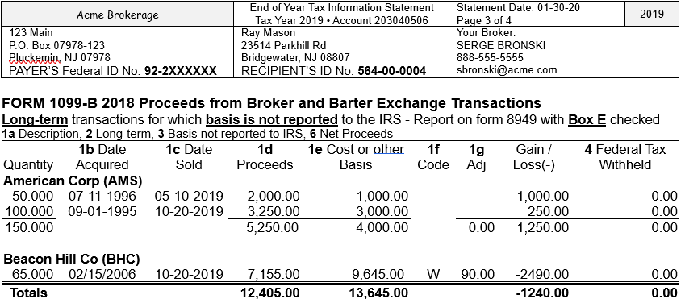
Consolidating 1099-B Transactions - One with a Wash Sales Adjustment

Slide 48
Consolidating 1099-B Transactions – One with a Wash Sales Adjustment
When can you consolidate multiple capital gains transactions instead on entering each transaction separately?
How do you tell TSO that your entry is a consolidated transaction?
How do you indicate a wash sale that has been disallowed?

Slide 49
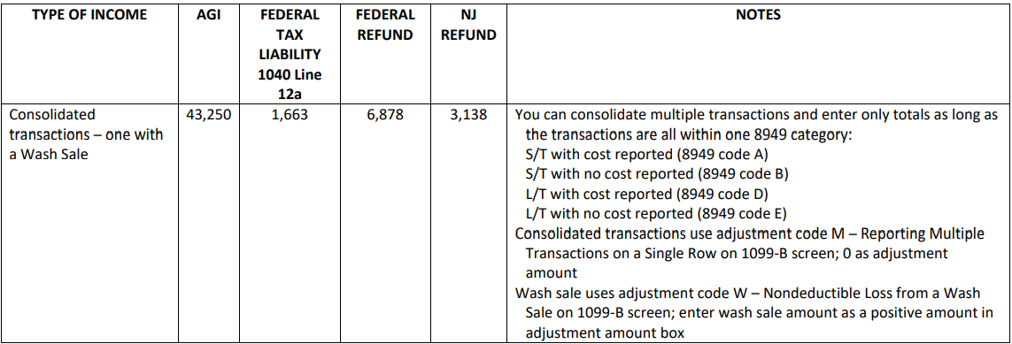
Consolidated Transactions – One with Wash Sale

Slide 50
Seller Financed Interest Income
Seller holds the mortgage on a home he/she sold and receives interest from the buyer on the mortgage loan
No tax form for the interest
Need payer’s name, address, Social Security #, and interest income buyer paid
Notes:
Instructor Note:

Slide 51
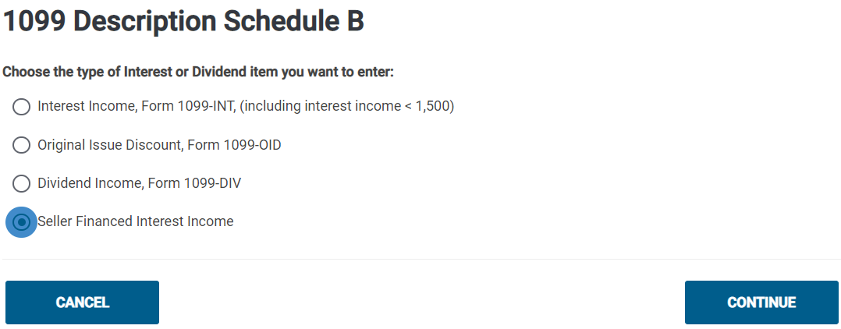
TSO Interest Sub-Menu

Slide 52
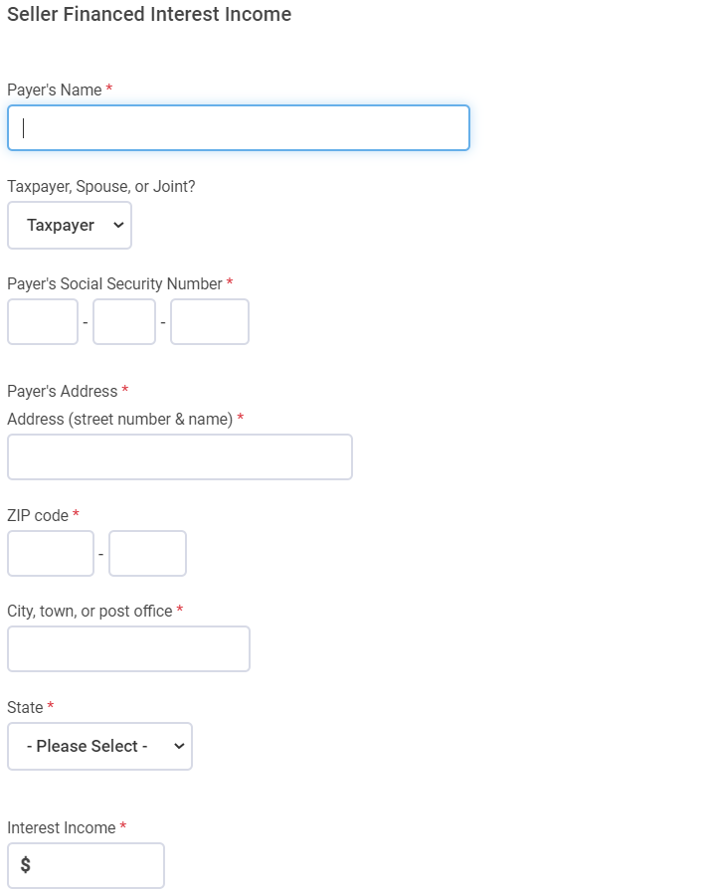
TSO – Seller Financed Interest Income

Slide 53
Sale of a Home
Houses are considered to be personal use assets (if not rental property – Out of Scope)
Gains from home sales are taxable; losses are not deductible
However, gains from selling your home may be excluded up to a certain amount if:
It’s a “main home”
Residency requirement is met
Ownership requirement is met
Similar gain not taken in the last 2 years

Slide 54
Sale of a Home What is Considered a “Main” Home?
Determined by facts – not by choice
Where taxpayer lives most of the time
Home must have cooking, sleeping and bathroom facilities
If taxpayer is living in a rental, the rental might be considered the main home
Other places may qualify (house, boat, mobile home, apartment, condo, etc.)
Land sale does not qualify
Notes:
Instructor Notes:
Reverse Mortgages are a non-tax event
Counselor does nothing
Related fees could impact cost basis when home is sold
If selling a non-main residence home, the loss can be considered a capital asset sale with a loss, entered on Capital Gains/Loss transaction worksheet
54

Slide 55
Home Sale Terms
Selling Price - includes all monies received plus any mortgages or other debts taken over by the buyer (does not include amounts received for personal property sold with home--e.g. furniture or appliances)
Amount Realized - the selling price minus selling expenses
Selling Expenses - commission, advertising, legal fees, loan charges paid by seller
Basis – actual cost if bought or built
Cost basis for property inherited in 2010 is lower of Fair Market Value at death or decedent’s cost basis Out of Scope
Adjusted Basis - the original cost plus/minus any increase or decrease to original basis (additions, eligible improvements)
Tax statement – Form 1099-S - Proceeds from Real Estate Transaction may be issued
Notes:
Instructor Notes:
Can only adjust basis for additions & improvements that have a useful life of more than one year
55

Slide 56
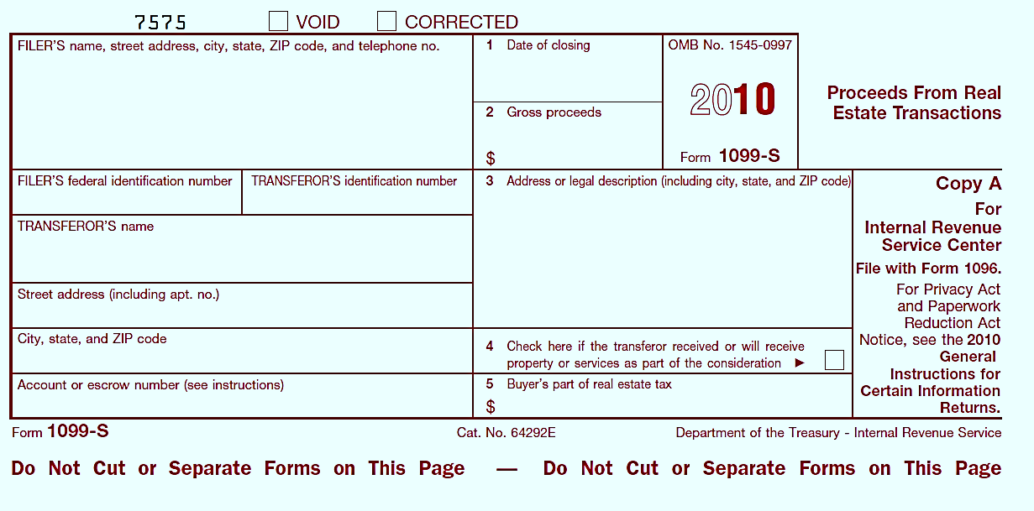
1099-S Proceeds From Real Estate Transaction
2019
Includes cash or notes received for property
Checked if other services or property is received as payment *
Note: 1099-S may not be provided if total gain can be excluded or if gains/loss from sale of other services or property are considered
Notes:
56

Slide 57
Calculating Home Sale Gain or Loss
Amount Realized
minus Adjusted Basis
==============
Gain or Loss
Loss on sale of main home cannot be deducted & is not reported on tax return (unless 1099-S is issued – covered later)
Notes:
Remember:
Amount realized = selling price minus selling expenses
Adjusted basis = original cost plus/minus any changes to basis
57

Slide 58
House Sale Gain Exclusion Ownership & Use Tests
Taxpayer who sold a qualified main home this year may qualify to exclude part or all of the gain from income *
Must meet ownership & use tests (during the 5-year period ending on the date of sale)
Ownership test - must have owned the home for at least 2 years AND
Use test - must have lived in the home as your main home for at least 2 years
Do not have to be the same 2 years for ownership & use tests
* Sale of home that is not “main home” is treated like sale of any personal use capital asset.
Exclusion does not apply. Gain on sales is reportable income, but loss is not deductible.
Notes:
58

Slide 59
Calculate House Sale Gain Exclusion
Single homeowner can exclude up to $250,000 of gain from sale of main home
Unmarried surviving spouse can exclude $500,000 if sale occurs within 2 years of spouse’s death
Married couple can exclude up to $500,000 of gain, if:
Filed a joint return
Both individuals meet the use test
If only one meets use test, refer to Pub 17 – Sale of Home
Either or both meet the ownership test
Neither individual excluded gain in the 2 years before the current sale
Notes:
Instructor Notes:
Exclusion can be used more than once in your life as long as it wasn’t taken in last 2 years
Pub 523 states if home was owned jointly and one spouse dies, decedent’s basis portion of home is adjusted to Fair Market Value at time of death. Surviving spouse’s basis remains the same. Total basis is the sum of these two numbers
59

Slide 60
When 1099-S is Issued
1099-S usually not issued if total gain can be excluded or if sale results in a loss
If 1099-S is issued anyway and total gain is excludable:
Enter data on Sale of Main Home Worksheet to notify IRS that gain was excludable
See Special Topics Document “Sale of a Main Home” on TaxPrep4Free Preparer page if gain/loss must be reported on tax return
Notes:
60

Slide 61
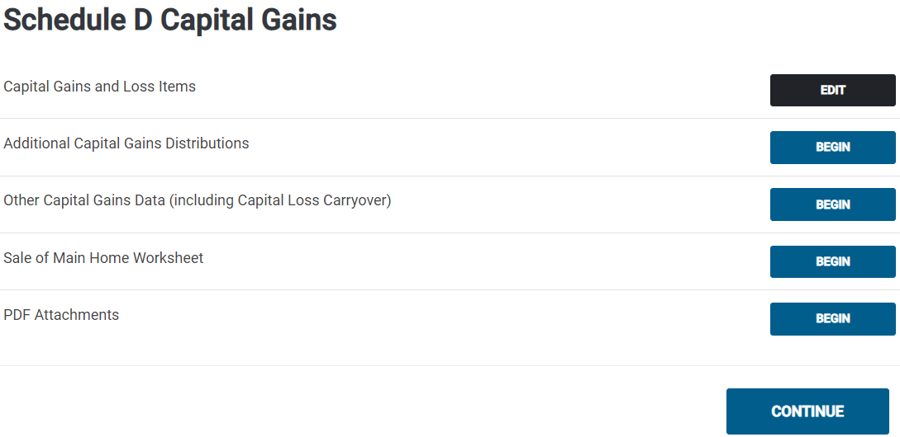
Sale of Main Home Worksheet

